Slide 1
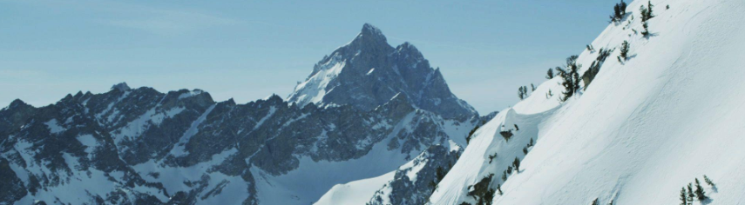
Big Mountain Resort: Price Analysis

Slide 2
The Problem
Current ticket price: $81
Operating cost increase: $1.54 m
The Ask
Propose a pricing strategy that capitalizes on facilities while cutting costs

Slide 3
Recommendation
Increase ticket price to $85
Increase vertical drop by 150 feet
Close 1 run

Slide 4
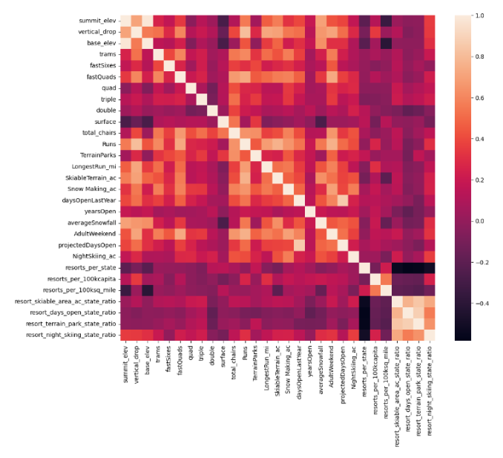
Modeling and Analysis
High correlation between ticket price and…
Fast Quads
Vertical Drop
Number of Runs
Snow Making Acreage

Slide 5
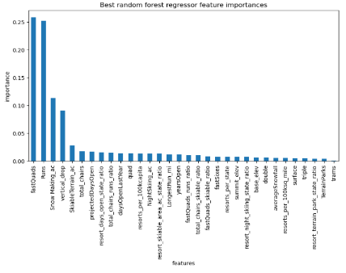
Our model ranked the same resort features as most important!

Slide 6
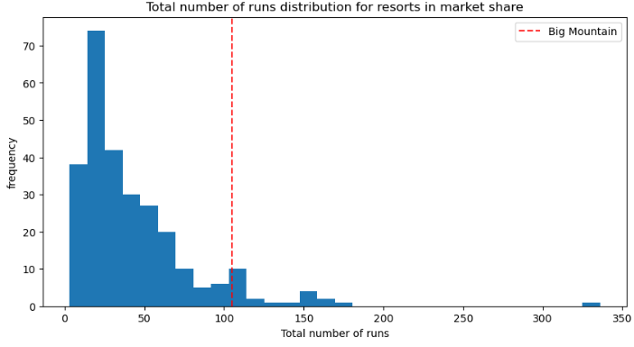
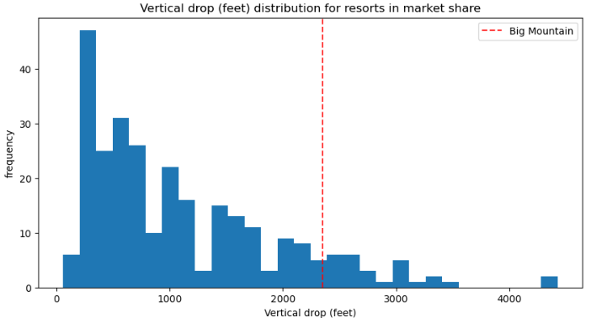
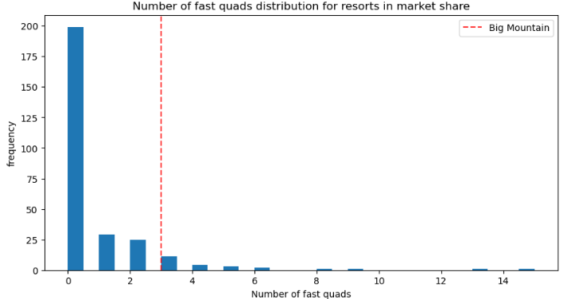
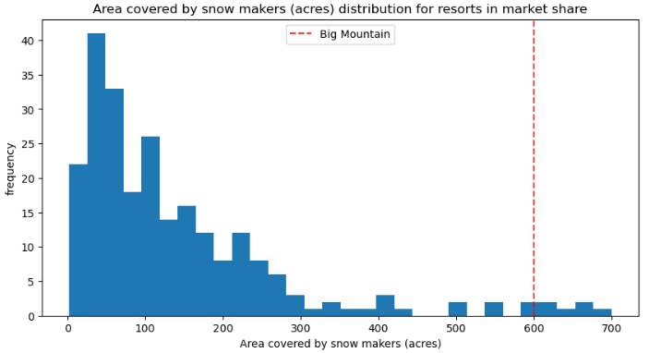
Big Mountain’s Current Position:

Slide 7
Big Mountain…
SUMMARY
…is already positioned with features that support a higher ticket price.
CONCLUSION
…can confidently increase it’s ticket price and further improve it’s pricing strategy by increasing it’s vertical drop and closing one run.

Slide 8
Any questions?
Thank you!

